Slide 1

Mobile Applications in Java Cohort: My Bicycle Shop For Android Flamingo 2022.2.1 Patch 1 Part 1: Developing the User Interface and Navigation
Carolyn J Sher-Decusatis

Slide 2
C196 Cohort and Webinar series: My Bicycle Shop
Part 1: Developing the User Interface and Navigation
Part 2: Setting up the Database using the Room Framework
Part 3: Displaying, Adding and Modifying Products and Parts
Part 4: Finishing Touches: Sharing Features, Notifications and Checking Terms for Courses before Deleting
The sample code for the completed application is available in the C196 code repository under My Bicycle Shop Sample Code>My Bicycle Shop for Android Dolphin

Slide 3

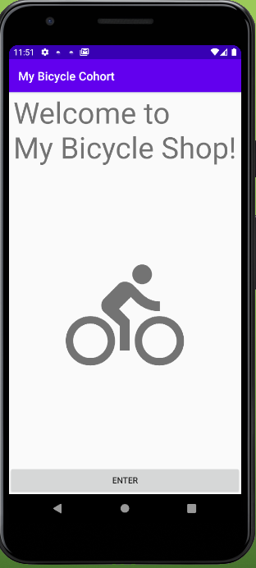
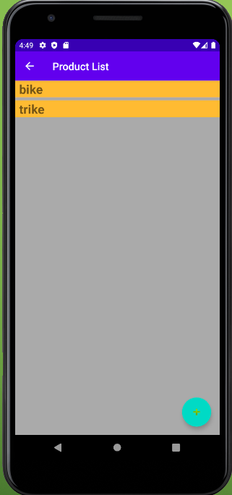
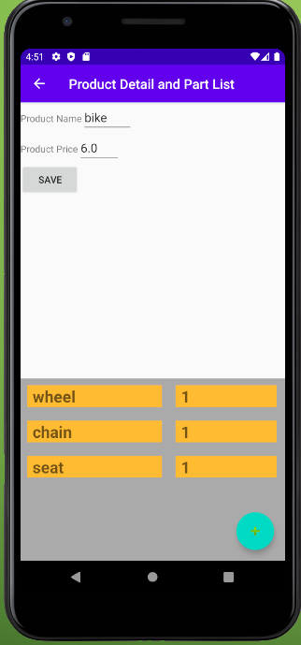
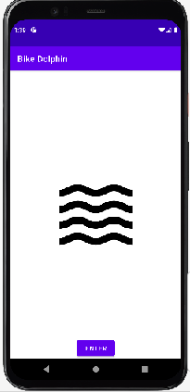
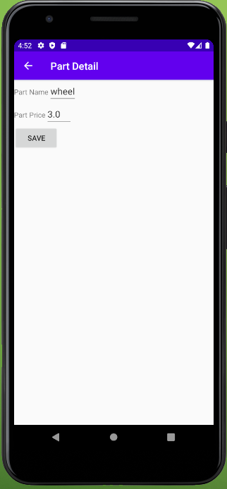
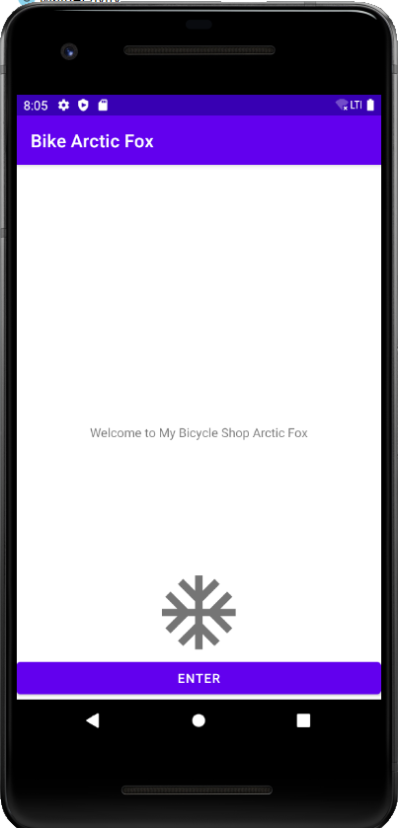
Part 1: Developing the User Interface and Navigation
In this series, we will develop a sample application based on techniques used in the zyBooks learning resource.
It has a two table database and four screens. It is reminiscent of the Software 1 project
The application is an inventory control system for a bicycle shop. You enter the application through the main screen, which has a picture and a button to enter. The second screen has a list of products, the third screen has details on the products and a list of parts associated with the products, and the fourth screen has details of the parts.
Notes:
Need to update screens

Slide 4
Android Fundamentals
The Android operating system is a multi-user Linux system in which each app is a different user.
The Android SDK tools compile your code along with any data and resource files into an APK, and Android package, which is an archive file with an .apk suffix.
When you have completed the project, you will generate a signed apk, which has been digitally signed with a certificate for which the developer holds the private key. This is the final step before uploading to Google Play, however you will not need to upload to Google Play.

Slide 5
App components
There are four different types of app components:
Activities- the entry point for interacting with the user. It represents a single screen with a user interface. (Fragments represent a portion of the user interface in an Activity, to create a multi-pane UI. Using them is not required in the assessment, and we will not be using them in this example.)
Services- a general purpose entry point for keeping an app running in the background.
Broadcast Receivers-a component that enables the system to deliver events to the app outside of the regular user flow.
Content Providers- they manage a shared set of app data that you can store in the file system. (In this example you will be using the Room Persistence Library, which wraps the SQLITE implementation and provides a different interface)

Slide 6
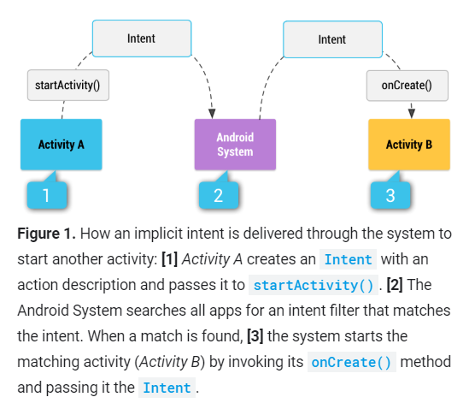
Intent and Intent Filters
An Intent is a messaging object you can use to request an action from another app component. There are three things major things they do (and all of them with be demonstrated in this project):
Start an activity
Start a service
Deliver a broadcast

Slide 7
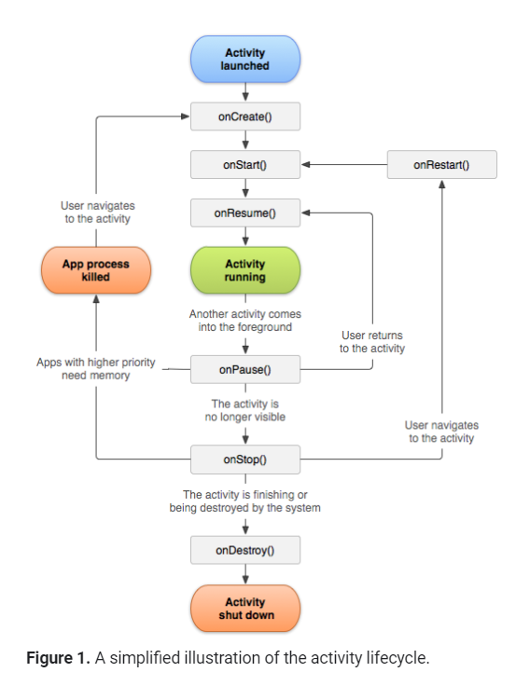
Android Activity Life Cycle
As a user navigates through, out of, and back to your app, the Activity instances transition through these different states.
The Activity class provides a set of six callbacks: onCreate(), onStart(), onResume(),onPause(), onStop() and onDestroy(). The system invokes these as an activity enters a new state. These methods have default values, but they can be overridden.

Slide 8
The screen design
The screen can be designed declaratively (with XML files in the layout resources) or programmatically.
To the right you can see an example of an XML layout file.
<?xml version="1.0" encoding="utf-8"?> <androidx.constraintlayout.widget.ConstraintLayout xmlns:android="http://schemas.android.com/apk/res/android" xmlns:app="http://schemas.android.com/apk/res-auto" xmlns:tools="http://schemas.android.com/tools" android:layout_width="match_parent" android:layout_height="match_parent" tools:context=".MainActivity"> <TextView android:layout_width="wrap_content" android:layout_height="wrap_content" android:text="Hello World!" app:layout_constraintBottom_toBottomOf="parent" app:layout_constraintLeft_toLeftOf="parent" app:layout_constraintRight_toRightOf="parent" app:layout_constraintTop_toTopOf="parent" /> </androidx.constraintlayout.widget.ConstraintLayout>

Slide 9
Navigation between screens
Add a back arrow to the toolbar by setting the parent in the Android Manifest
Add an additional method to close screen->
Add the onResume() to the prior screen, and have it refresh anything that needs refreshing
@Override
protected void onResume(){
Super.onResume();
Toast.makeText(ProductDetails.this,”refresh list”,Toast.LENGTH_LONG).show();
}
@Override
public boolean onOptionsItemSelected(MenuItem item){
if(item.getItemId()== android.R.id.home){
this.finish();
return true;
}
return super.onOptionsItemSelected(item);
}
}

Slide 10
Androidx libraries
We are going to use Androidx libraries in Part 2, so that means:
Our Constraint layouts must be from the library androidx.constraintlayout.widget.ConstraintLayout
In older versions of Android Studio you would have to add to the gradle.properties
android.useAndroidX=true
android.enableJetifier=true
It is automatically in the latest version of Arctic fox.
Add to the build.gradle(Module)
// UI implementation "androidx.constraintlayout:constraintlayout:$rootProject.constraintLayoutVersion" implementation "com.google.android.material:material:$rootProject.materialVersion“
And to the build.gradle(project)
ext{
constraintLayoutVersion=‘2.0.4’
materialVersion=‘1.2.1’ }

Slide 11
How we start
Open a new project with an empty views activity.
Open a package for the UI (user interface),and for the Database,and move the main activity file into the UI Package.
Add a button to open the Product Activity screen. Give it an onclick listener. Have the onclick listener open the ProductList screen (You can also put an image on the MainActivity if you like.)
Add a new empty activity for the ProductList. Be sure to import R if needed.
Add backwards navigation. Add a label to the activity in the manifest called “Product List”.
Add a floating action button. Import a drawable vector asset plus sign (add) and use it on the FAB. Give it an onclick listener. Have the onclick listener open the PartList screen
Add a new empty activity for the PartList. Be sure to import R if needed.
Add backwards navigation. Add a label in the manifest called “Part List”
Add a floating action button. Give it an onclick listener. Have the onclick listener open the PartDetail screen
Add the activity for the Part Details. Be sure to import R if needed.
Add backwards navigation
Add some textviews and editTexts to the details screen (ctrl_Alt+L to tidy)
Hint-Ctrl+Alt+L will tidy up your code

Slide 12
Saving to GitLab
Version/Create a Git Repository
Open a repository in GitLab (run the pipes for D308)
Manage remote to the working branch of that repository
Commit and push

Slide 13
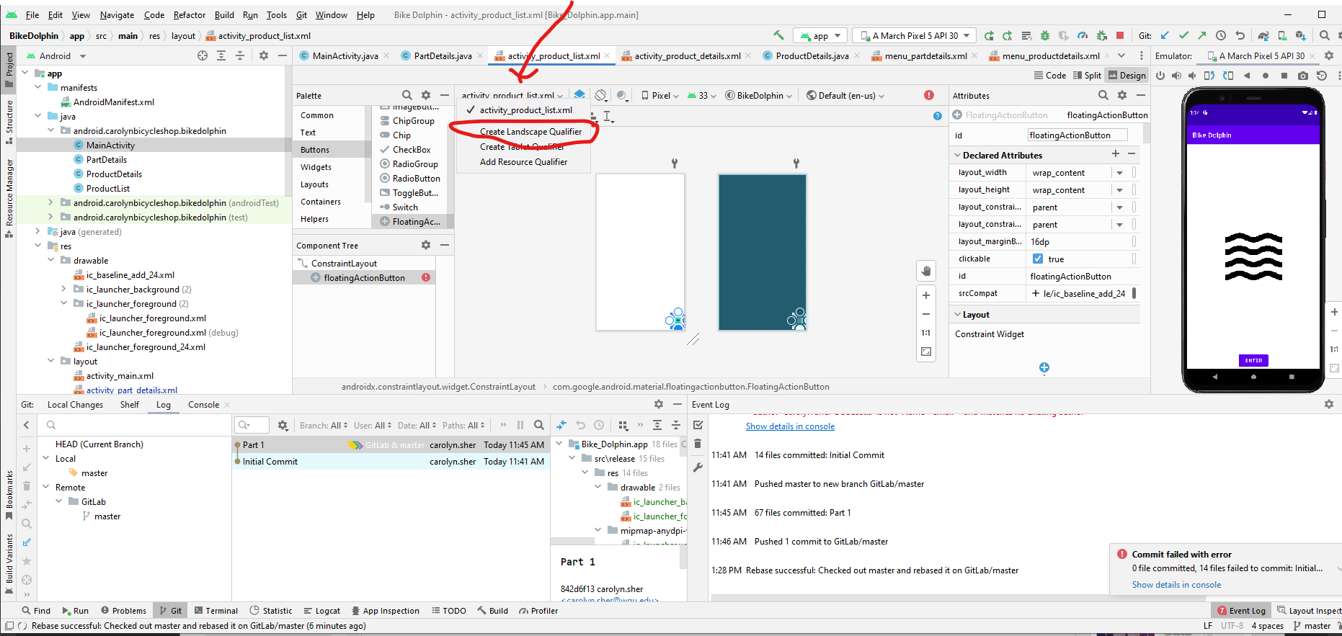
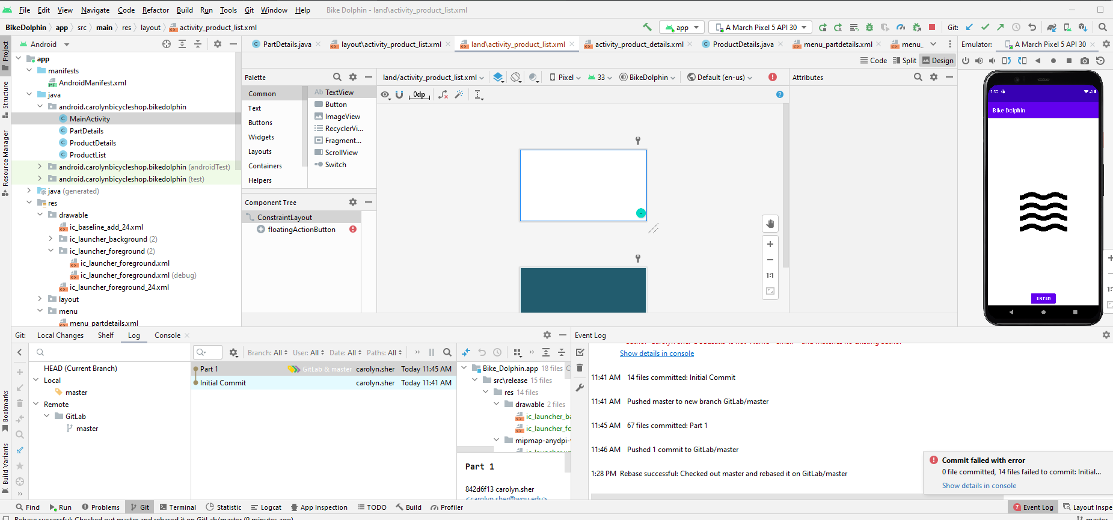
Creating a Landscape qualifier in the design mode (do not do this until you have finished your application)

Slide 14
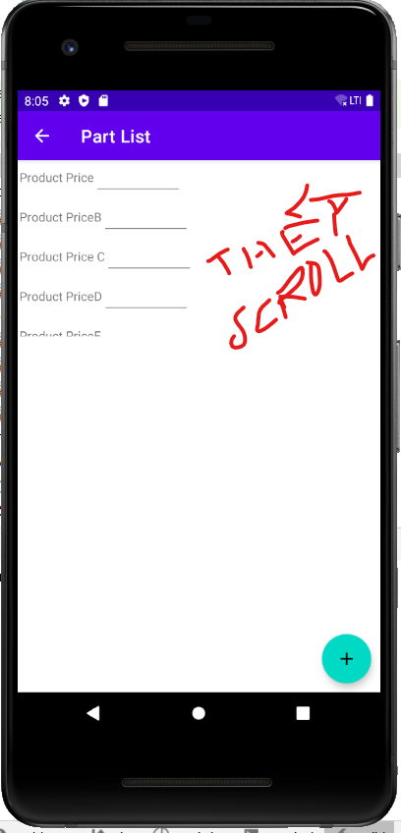
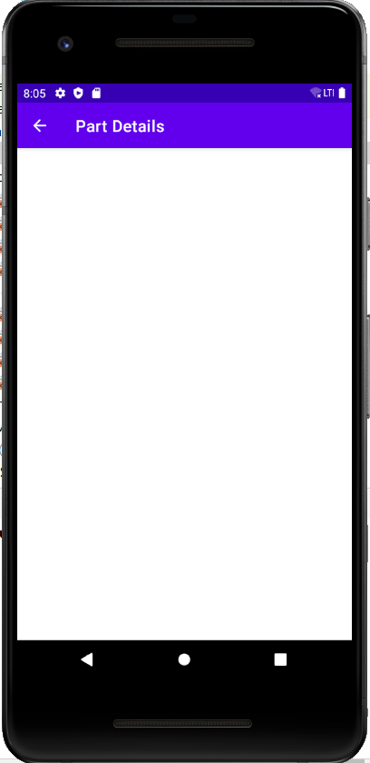
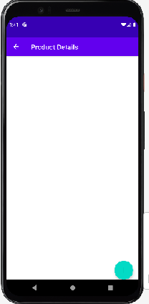
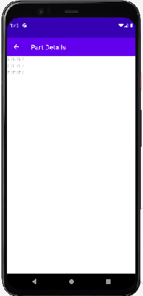
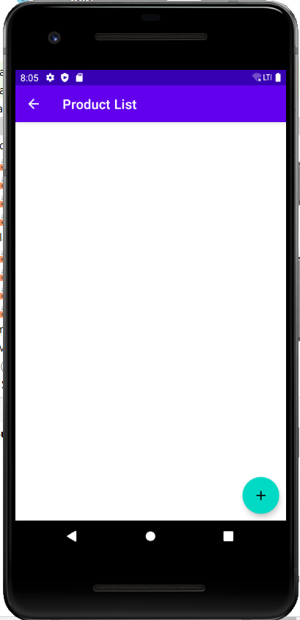
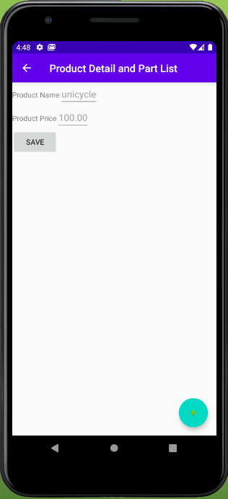
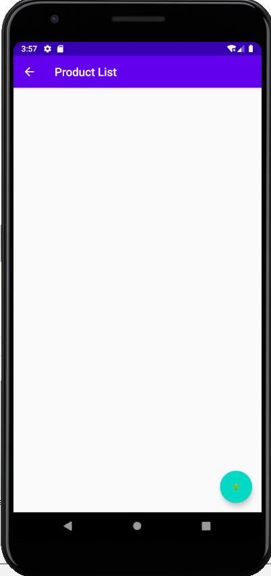
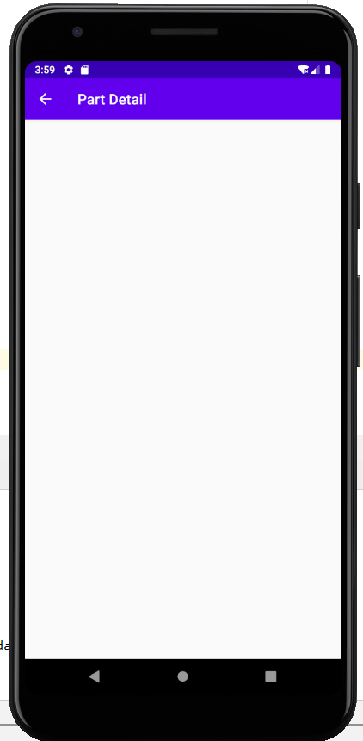
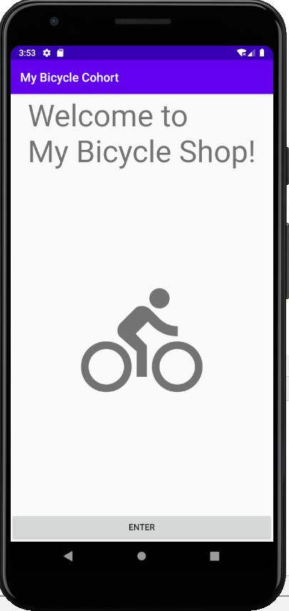
Our Result
My Bicycle Shop 1

Slide 15
Now you
You can use the same techniques to begin your assessment.
See you next time!

Slide 16

Mobile Applications in Java Cohort: My Bicycle Shop For Android Android Flamingo 2022.2.1 Patch 1 Part 2: Setting up the Database using the Room Framework
Carolyn J. Sher-Decusatis

Slide 17
What is The room persistence framework
Room provides an abstraction layer over SQLite to allow fluent database access while harnessing the full power of SQLite.
Apps that handle non-trivial amounts of structured data can benefit greatly from persisting that data locally. The most common use case is to cache relevant pieces of data. That way, when the device cannot access the network, the user can still browse that content while they are offline. Any user-initiated content changes are then synced to the server after the device is back online.
Because Room takes care of these concerns for you, we highly recommend using Room instead of SQLite.

Slide 18
Some definitions
Entity: When working with Architecture Components, this is an annotated class that describes a database table.
SQLite database: On the device, data is stored in an SQLite database. For simplicity, additional storage options,
such as a web server, are omitted. The Room persistence library creates and maintains this database for you.
DAO: Data access object. A mapping of SQL queries to functions.
You used to have to define these painstakingly in your SQLiteOpenHelper class.
When you use a DAO, you call the methods, and Room takes care of the rest.
Room database: Database layer on top of SQLite database that takes care of mundane tasks that you used to
handle with an SQLiteOpenHelper Database holder that serves as an access point to the underlying SQLite database.
The Room database uses the DAO to issue queries to the SQLite database.
Repository: A class that you create, for example using the WordRepository class.
You use the Repository for managing multiple data sources.
.
Source: Android Room with a View

Slide 19
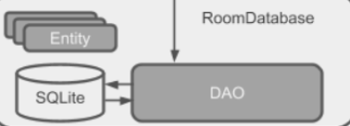
Components
UI Components
Displays Data, forwards UI events
Repository
Connects to Database Asynchrounously
Manages local SQLite data source using objects

Slide 20
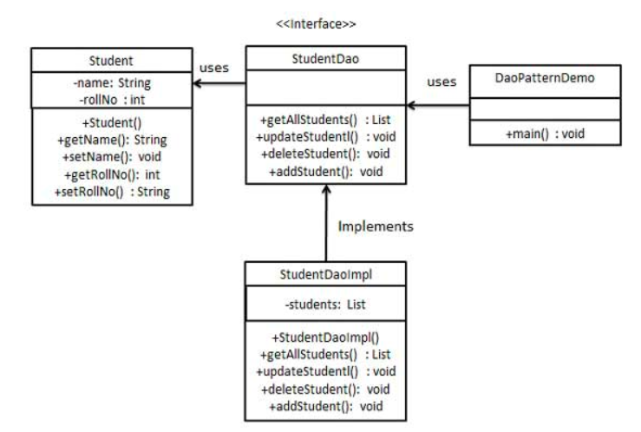
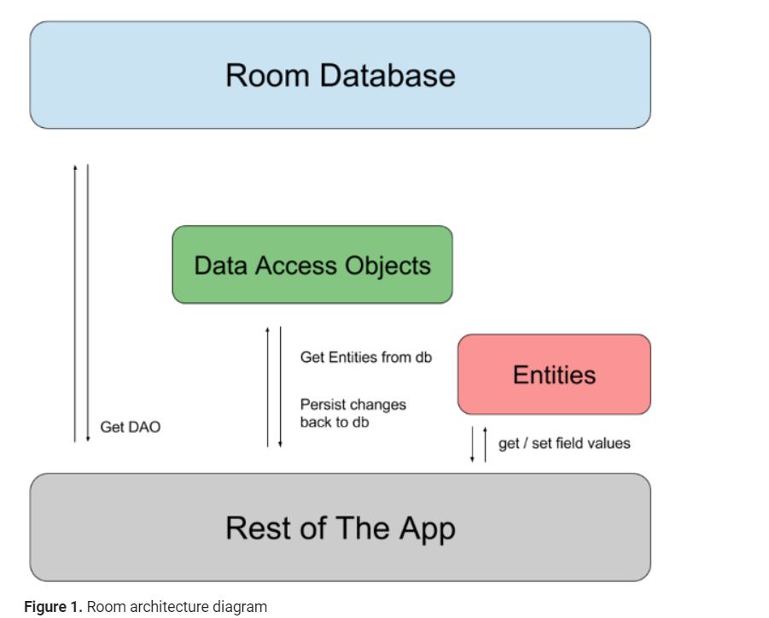
The data access object pattern
Android.developers.com

Slide 21
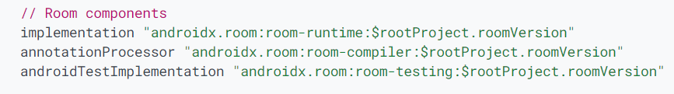
Updated gradle files(from Android Room with a view)
Next, you'll have to add the component libraries to your Gradle files.
In Android Studio, click the Projects tab and expand the Gradle Scripts folder.
Open build.gradle (Module: app).compileOptions { sourceCompatib}
3. Add the following code to the end of the dependencies block:
(this doesn’t count as an external library to evaluation, since it was developed by Google for Android, and is not 3rd party.)
4.In your build.gradle (Project: My_Bicycle_Cohort) file, add the version numbers to the end of the file, as given in the code below:
ext{
roomVersion=‘2.5.1’
}
5.Sync your project.
source-Android Room with a View (Java) (Check for updates there)

Slide 22
The synchronous and asynchronous connecting to the database
From Developers documentation https://developer.android.com/training/data-storage/room/accessing-data
Note: Room doesn't support database access on the main thread unless you've called allowMainThreadQueries() on the builder because it might lock the UI for a long period of time. Asynchronous queries—queries that return instances of LiveData or Flowable—are exempt from this rule because they asynchronously run the query on a background thread when needed.

Slide 23
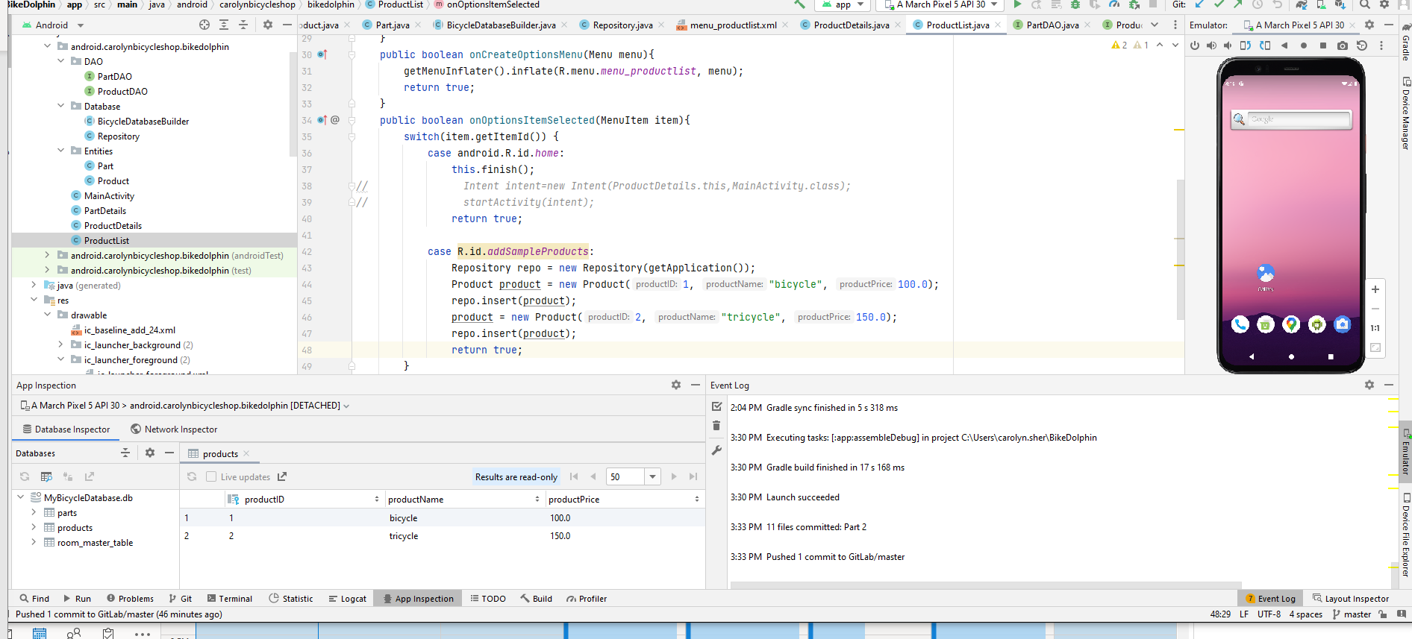
Check the database
Use a menu to add sample products to database
Use App Inspection if you are adding parts and products asynchronously
If you are adding parts and products synchronously, it may be locked, or it may work- I’ve seen both

Slide 24
Setting Up the Database
Make packages for Entities, DAO, and Database.
Add Entities to the Entities package, DAO implementation files to the DAO package, and Database creation and Repository files to the Database package. Remember your annotations! Whenever you change the database by changing the entities, you will need to increment the version number of the database.
Add sample data to the database the main activity
Run the application and check the data is in the database using database inspector (under app inspection)
Note: Since we have not yet gone over deleting, if you want to clear out the database increment the version number.

Slide 25
Now you
You can use the same techniques to write the tables in your application.
See you next time!

Slide 26
Mobile Applications in Java Cohort: My Bicycle Shop For Android Android Flamingo 2022.2.1 Patch 1 Part 3: Displaying, Adding and Modifying Products and Parts
Carolyn J. Sher-Decusatis

Slide 27
We are going to list our products and Parts in Recyclerviews
A RecyclerView is a container that displays rows of data with optimized memory usage
Since RecyclerView isn’t included in the Android SDK the support library is automatically added to the build.gradle file (this doesn’t count as an external library to evaluation, since it was developed by Google for Android, and is not 3rd party)

Slide 28
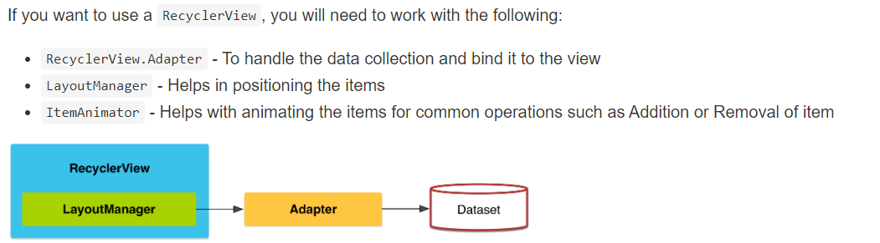
RecyclerViews
https://guides.codepath.com/android/Using-the-RecyclerView

Slide 29
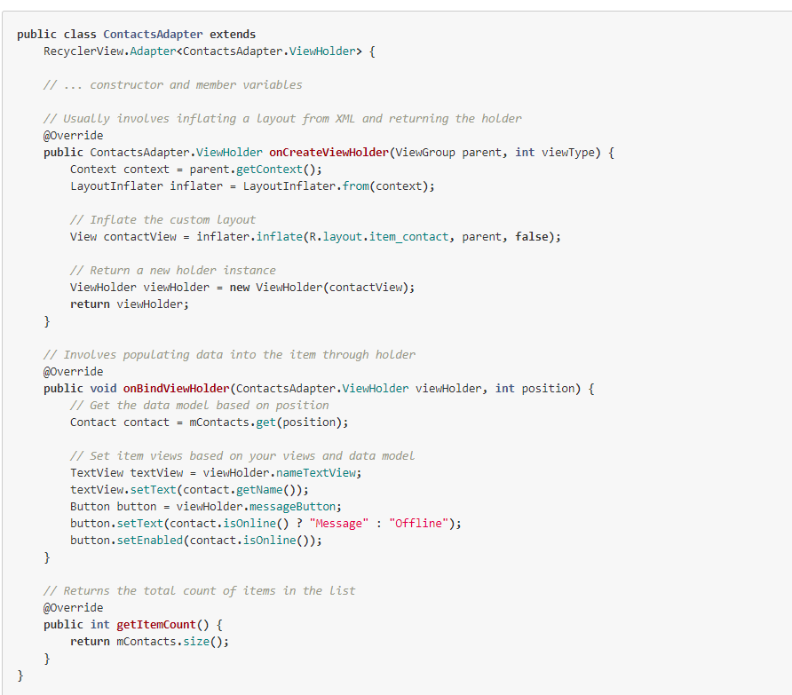
Adapters
With a RecyclerView the adapter requires the existence of a "ViewHolder" object which
describes and provides access to all the views within each item row.
Every adapter has three primary methods: onCreateViewHolder to inflate the item layout and create the holder, onBindViewHolder to set the view attributes based on the data and getItemCount to determine the number of items. All three have to be implemented to finish the adapter

Slide 30
We want to click on an item and have the data populate on a detail screen
I do this by putting an onClickListener on the itemview in the constructor for the view holder.
In LinkedIn Learning’s Building an Android App with Architectural Components David Gassner does it by putting an onClickListener on a widget in the itemview in the onBindViewHolder

Slide 31
Refreshing the lists (Reminder from Part 1)
If you go to the PartList screen using an Intent it automatically refreshes the list, but it doesn’t keep the product information.
Since we need the product information, we finish the PartDetails screen, and it goes back to the PartList screen where we left it, with a list of parts that hasn’t been refreshed.
To refresh the recyclerview, I’ve added a onResume() method

Slide 32
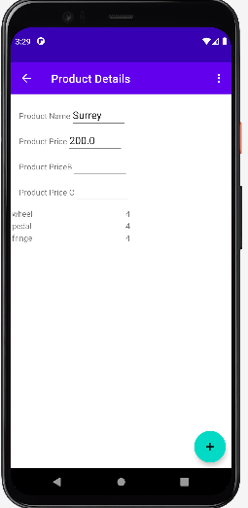
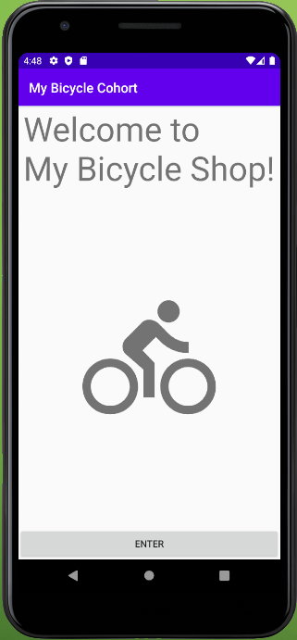
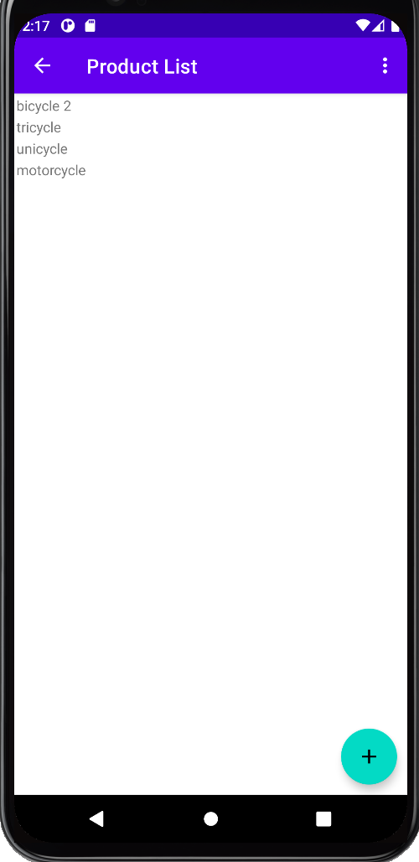
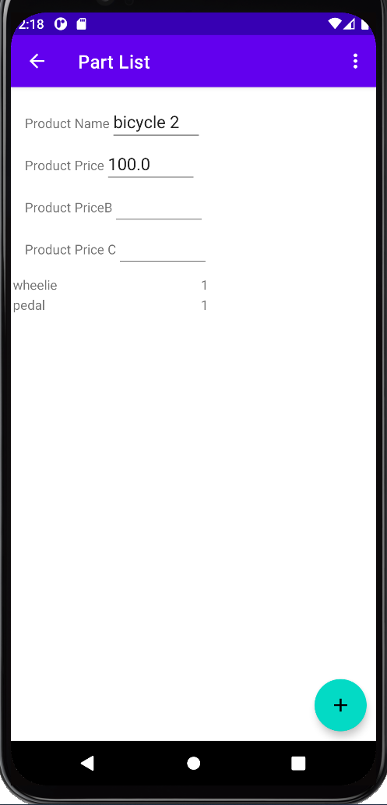
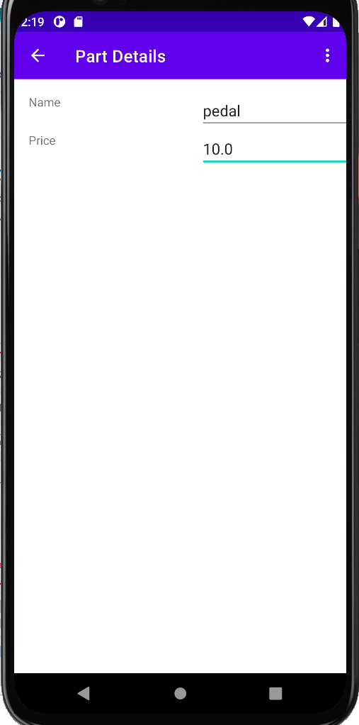
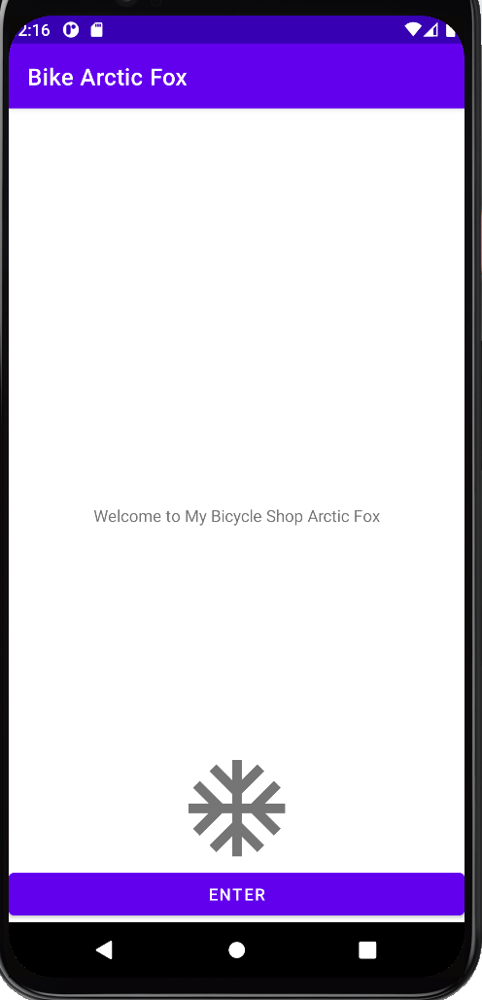
Display your sample data on the recyclerview using an adapter
Save new Products and Parts to the database on the detail page
To update Products and Parts add to the constructor of the View Holder inner class of the Adapter class add an itemView.setOnClickListener to add an extra to the intent that starts the detail page, and save the updated item on the detail page
Include correct productid information in parts using intents
Find the correct id by using 1 if there aren’t any objects, and incrementing the id of the last object on the list if there are
Add the onResume() so screen updates (see life cycle from Part 1)
Show only the parts associated with a product by filtering the list

Slide 33
Now you
You can use the same techniques on your application.
See you next time!

Slide 34
Mobile Applications in Java Cohort: My Bicycle Shop For Android Flamingo 2022.2.1 Patch 1 Part 4: Finishing Touches: Sharing Features, Notifications, checking terms for courses before deleting, and spinners
Carolyn J. Sher-Decusatis

Slide 35
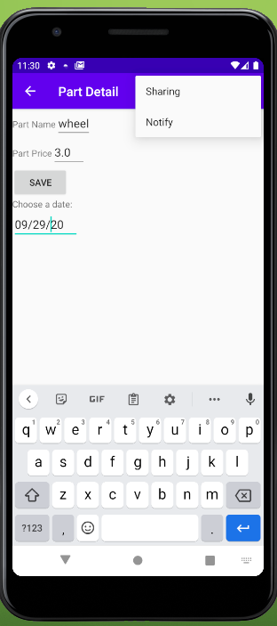
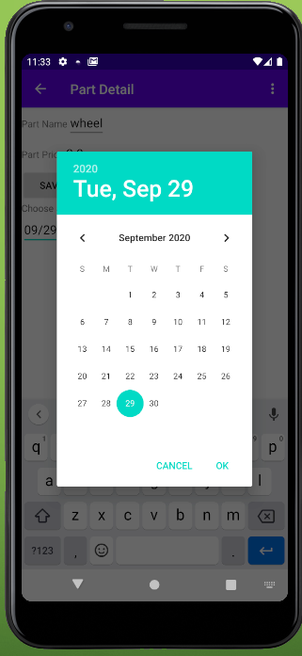
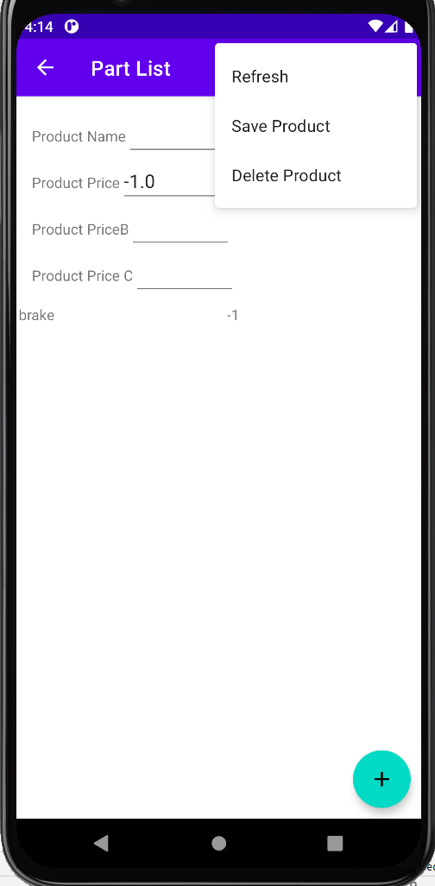
Adding Sharing features and Notifications
I’ve added a new menu to the parts detail for sharing features and notifications. I’ve also added a pop-up datepicker to pick a date to sent the notifications.
Notes:
Revise picture to use a pop-up datepicker

Slide 36
Adding to the Menu
Make a custom menu for the screen including relevant menu items and inflate the menu
Implement onOptionsItemSelected(MenuItem item) and
add sharing and notifications to the menu resources
Add the titles to the string resources

Slide 37
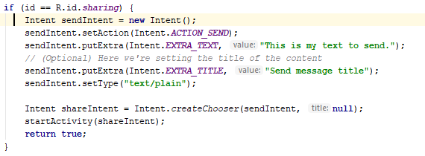
Sharing features
We add a Chooser target, so the program can pick between email or text applications on the emulator
You can send information to the application using extras

Slide 38
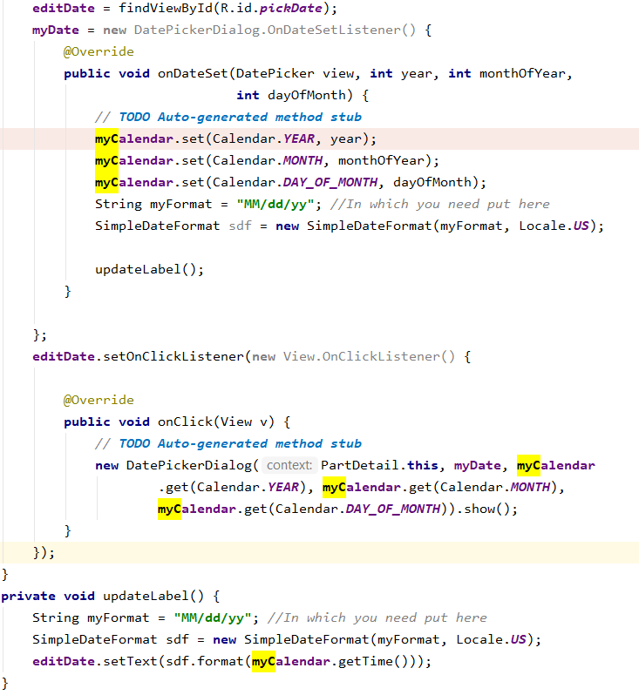
Notifications
First we put in the pop up datepicker, and set the myCalendar to that date

Slide 39
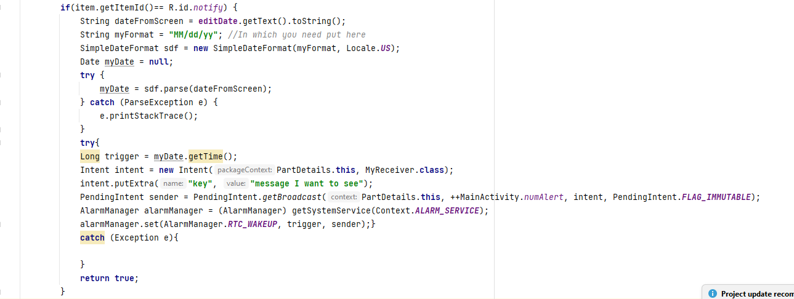
Then we setup a pending intent to run a broadcast receiver at that date
Messages that you want to place in the notifications can be sent to the broadcast receiver as extras on the intent.
Make sure your broadcast receiver is registered in the Android Manifest
Make sure you increment the request code (numAlert) so your notifications don’t overwrite each other. Use the same numAlert variable even if the notification is sent from a different screen-just make the variable public and static.
Notes:
Update picture

Slide 40
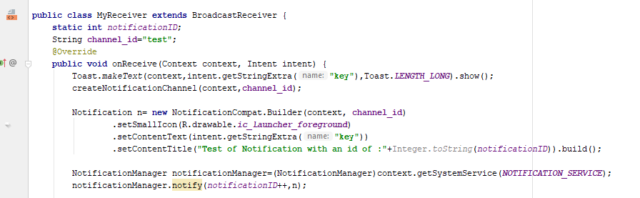
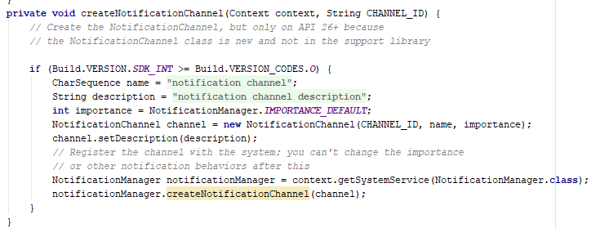
The broadcast receiver creates a notification channel and sends the notification when triggered
Notes:
Update picture

Slide 41
checking terms for courses before deleting
There are lots of ways this should work that don’t work well and are really really frustrating. So I’ve added to this series a simple but clunky way that works, deleting from the term detail screen.

Slide 42
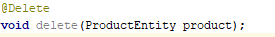
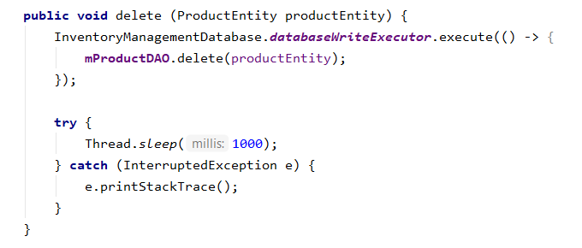
Steps
Add the ability to delete the product to the DAO, and Repository
Add to ProductDAO
Add to InventoryManagementRepository

Slide 43
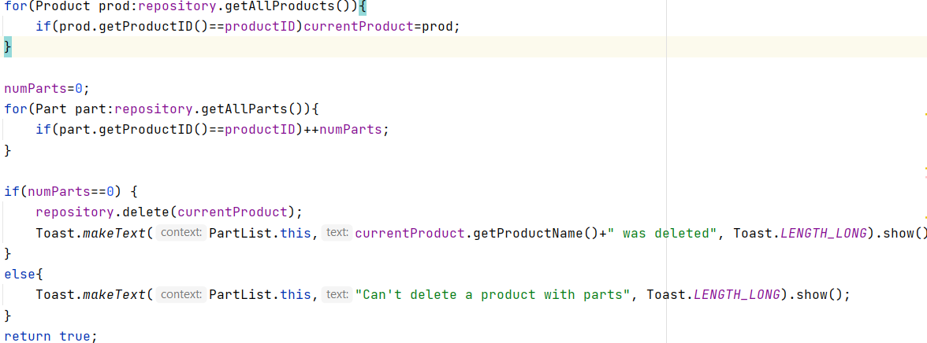
To Make it active
Add a menu to delete to PartActivity
Find the current product
Add a variable numParts=0
Count the number of parts associated with the product
If the number 0 delete the product. Otherwise, send a toast saying you can’t delete the product.

Slide 44
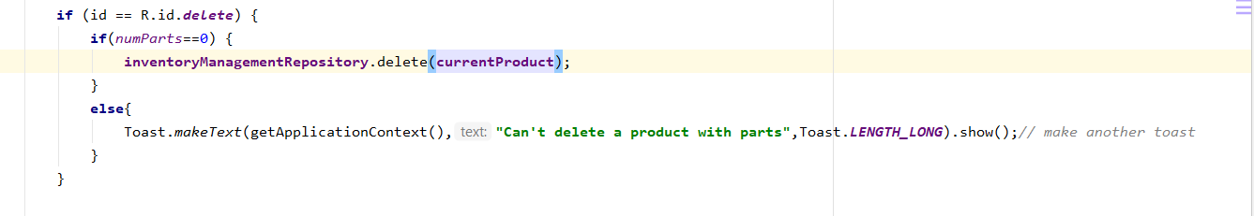
Then have the menu check if there are parts, and if not, delete
Notes:
Update picture so doesn’t use live data

Slide 45
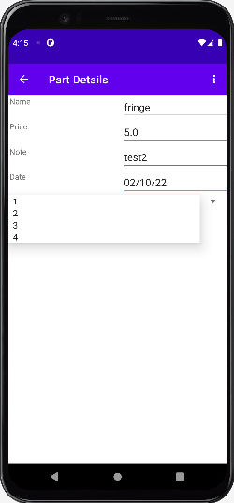
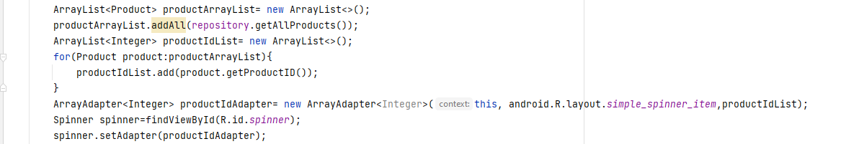
Spinners, the combo boxes of Android
Put a spinner in the layout
Make an ArrayList of everything you want to show on the spinner
Make an ArrayAdapter with that ArrayList on it
Set the adapter on the spinner
(for more details see the Android Bits Spinner webinar)

Slide 46
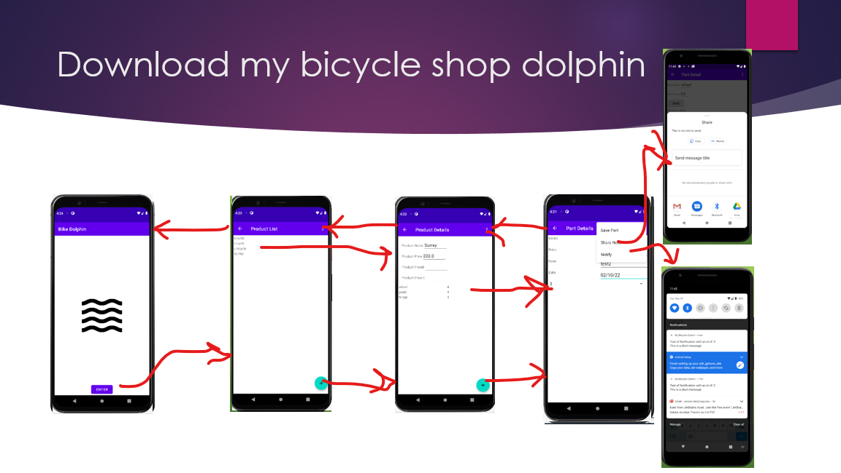
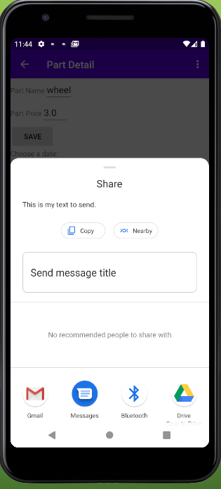
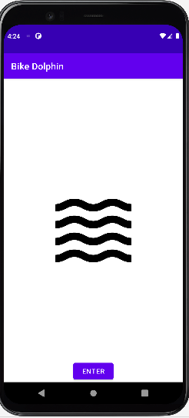
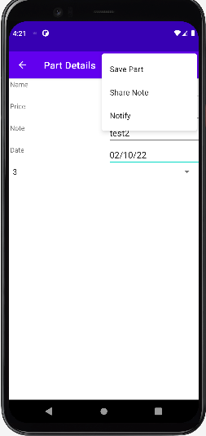




Download my bicycle shop dolphin
Notes:
Update this picture

Slide 47
Now you
You can use the same techniques to add sharing features, notifications and deleting terms without courses to your assessment.
Happy coding!

Slide 48
References
Android Developers Forum: https://developer.android.com/
https://codelabs.developers.google.com/codelabs/android-room-with-view/#0
https://guides.codepath.com/android/Using-the-RecyclerView
https://www.youtube.com/watch?v=vOJCrbr144o
https://www.youtube.com/watch?v=FrteWKKVyzI
LinkedIn Learning’s Building an Android App with Architectural Components by David Gassner

